Slide 1
Guaranteed Energy Savings
Performance Contracting
Energy Services Coalition
www.energyservicescoalition.org

Slide 2
What is it?
“The use of guaranteed savings from the maintenance and operations budget (utilities) as capital to make needed upgrades and modernizations to your building environmental systems, financed over a specified period of time.”
-United States Department of Energy

Slide 3
Another Perspective
A re-purposing of utility dollars to effect . . .
  Infrastructure Modernization
  Economic Development
  Environmental Stewardship

Slide 4
Benefits of Guaranteed Energy Savings Performance Contracting
Long Term Reduction in Operating Costs
Improved Learning and Working Environments
Elimination of Deferred Maintenance Lists
Reducing Capital Needs
Creates local construction job opportunities

Slide 5
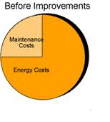

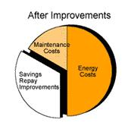
How Does The Money Flow?
Client
Excess
Savings
Utility and
operations budget
Finance Repayment
Finance
Finance
ESPC Project
Savings from Improvements

Slide 6
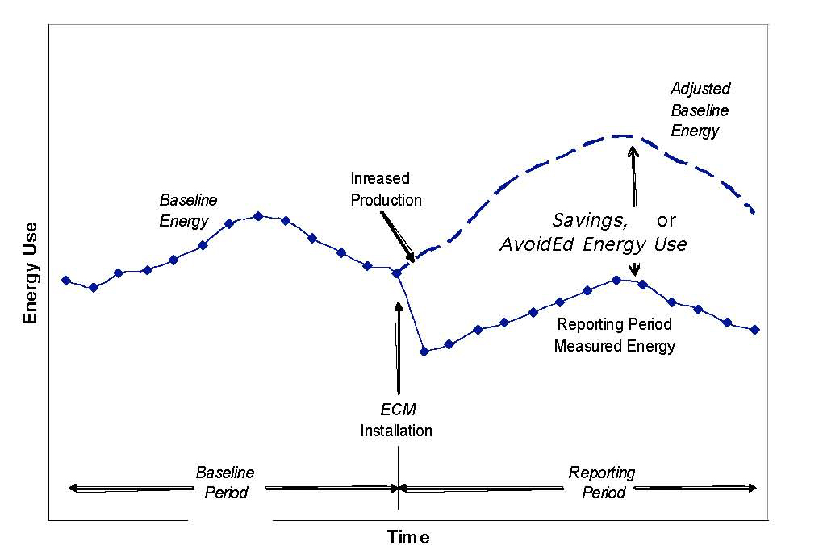
Results

Slide 7
To Do What?

Slide 8
Applications
  Buildings
  Transportation
  Water purification facilities
  Water sewage facilities
  Waste utilization
  Solar and wind applications

Slide 9
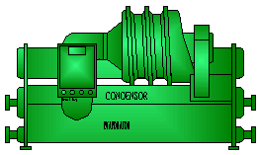
Typical Process
Performance
Management
Project
Development
Workshops
and Interviews
Measurement
& Verification
Comprehensive
Energy Audit
S
Single Source
Funding
Coordination
Training
of Responsibility
Project
Commissioning
Engineering
and Design
Construction
Installation
Equipment Selection
Construction
Management
Implementation

Slide 10
Financing Vehicles
Tax Exempt Municipal Lease
Bonds
  Traditional
  Tax Credit Bond Financing
  Community Development Bonds
Grants and Incentives
  Utility Incentives
  Federal Incentives

Slide 11
Why Use Guaranteed Energy Savings Performance Contracting?
Speed of Process from beginning to post construction
Single Point Accountability before, during, and after the construction period.
Quality Assurance – Performance and savings are guaranteed

Slide 12
Benefits
Contractually guaranteed measured savings
Integrated project analysis, design, and construction
Long term monitoring of savings and performance
Services and materials based upon quality and life cycle value, rather than on lowest first cost

Slide 13
More Benefits
Infrastructure modernization – new more energy efficient systems and devices
Environmental stewardship – reduced Green House Gas emissions
Economic development – real jobs now
Long term reduction in operating costs
Improved working and learning environments
Elimination of Deferred Maintenance lists
Distribution Grid relief
Uptake of local utility incentive programs
Avoidance of generation requirements
Avoids emergency replacement of failing or near end of life equipment and systems
Improves attitudes and productivity of working and learning environment

Slide 14
Still More Benefits
Inspires good stewardship at homes, in industry and in commercial businesses through public leadership
Engages private sector dollars to fulfill public sector needs
Can engage underutilized public staff personnel in oversight roles that may not have had other construction projects in economic downturn
Transforms the marketplace to think of life cycle value over lowest first cost to obtain long term efficiency
Eliminates ongoing repair of failing equipment
Lowers complaints and frustration that comes from failing systems and uncomfortable work spaces
Employs construction workers – one of the hardest hit industries
Affords existing maintenance staff an enhanced learning opportunity to be trained on newer technologies.

Slide 15
Measurement and Verification
A. Retrofit Isolation: Key Parameter Measurement
B. Retrofit Isolation: All Parameter Measurement
C. Whole Facility
D. Calibrated Simulation
International Performance Measurement and Verification Protocol

Slide 16
Questions
For more information or assistance with your program or project, contact us at
info@energyservicescoalition.org

