Slide 1
Energy Savings
Performance Contracting
Presenters Name
Energy Services Coalition
www.energyservicescoalition.org

Slide 2
What is it?
“The use of guaranteed savings from the maintenance and operations budget (utilities) as capital to make needed upgrades and modernizations to your building environmental systems, financed over a specified period of time.”
-United States Department of Energy

Slide 3
Another Perspective
A re-purposing of utility dollars to effect . . .
  Infrastructure Modernization
  Economic Development
  Environmental Stewardship
  Our Nation’s Safety

Slide 4
Benefits of Energy Savings Performance Contracting
Real Jobs Now
Tax Revenue Generator
Long Term Reduction in Operating Costs
Improved Learning and Working Environments
Elimination of Deferred Maintenance Lists
Reducing Capital Needs
National Security

Slide 5
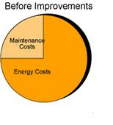

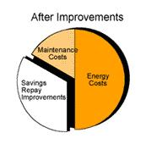
How Does The Money Flow?
Client
Excess
Savings
Utility and
operations budget
Finance Repayment
Finance
Finance
ESPC Project
Savings from Improvements

Slide 6
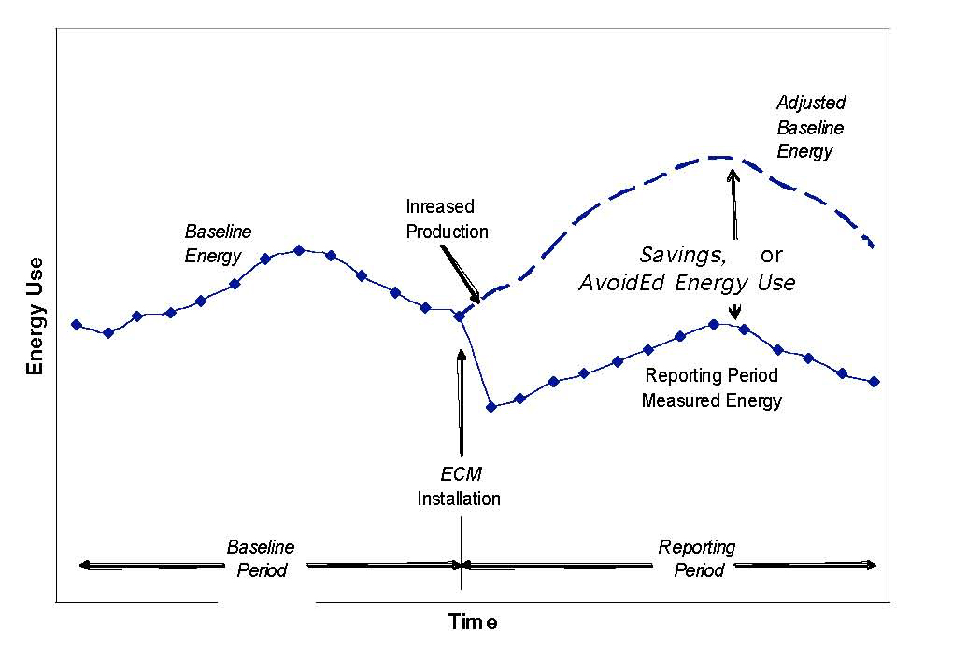
Results

Slide 7
To Do What?

Slide 8
Applications
  Buildings
  Transportation
  Water purification facilities
  Water sewage facilities
  Waste utilization
  Solar and wind applications

Slide 9
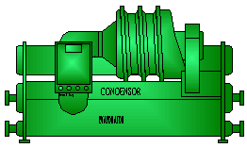
Typical Process
Performance
Management
Project
Development
Workshops
and Interviews
Measurement
& Verification
Comprehensive
Energy Audit
S
Single Source
Funding
Coordination
Training
of Responsibility
Project
Commissioning
Engineering
and Design
Construction
Installation
Equipment Selection
Construction
Management
Implementation

Slide 10
Financing Vehicles
Municipal Lease
http://energyservicescoalition.org/resources/financing.htm
Bonds
  Traditional
  Tax Credit Bond Financing
  Community Development Bonds
Grants and Incentives
  Utility Incentives
  American Recovery and Reinvestment Act Incentives

Slide 11
Why Use Energy Performance Contracting?
Speed of the process from beginning to post construction
Single Point Accountability before, during, and after the construction period.
Quality Assurance – Performance and savings are guaranteed

Slide 12
Benefits
Contractually guaranteed measured savings
Integrated project analysis, design, and construction
Long term monitoring of savings and performance
Services and materials based upon quality and life cycle value, rather than on lowest first cost

Slide 13
More Benefits
Infrastructure modernization – new more energy efficient systems and devices
Environmental stewardship – reduced Green House Gas emissions
Economic development – real jobs now
Long term reduction in operating costs
Improved working and learning environments
National Security
Elimination of Deferred Maintenance lists
Distribution Grid relief
Uptake of local utility incentive programs
Avoidance of generation requirements
Avoids emergency replacement of failing or near end of life equipment and systems
Improves attitudes and productivity of working and learning environment

Slide 14
Still More Benefits
Inspires good stewardship at homes, in industry and in commercial businesses through public leadership
Engages private sector dollars to fulfill public sector needs
Can engage underutilized public staff personnel in oversight roles that may not have had other construction projects in economic downturn
Transforms the marketplace to think of life cycle value over lowest first cost to obtain long term efficiency
Eliminates ongoing repair of failing equipment
Lowers complaints and frustration that comes from failing systems and uncomfortable work spaces
Employs construction workers – one of the hardest hit industries
Affords existing maintenance staff an enhanced learning opportunity to be trained on newer technologies.

Slide 15
Measurement and Verification
A. Retrofit Isolation: Key Parameter Measurement
B. Retrofit Isolation: All Parameter Measurement
C. Whole Facility
D. Calibrated Simulation

Slide 16
Questions
Unresolved . . .
Raises another thought . . .
But what about . . .
Tell me more about . . .

Slide 17
Resources
www.energyservicescoalition.org
Performance Contracting and Energy Efficiency in the State Government Market
http://eetd.lbl.gov/EA/EMP/reports/lbnl-1202e.pdf
Introduction to Energy Performance Contracting
http://www.energystar.gov/ia/partners/spp_res/Introduction_to_Performance_Contracting.pdf
Emerging Technologies for Energy Savings Performance Contracting in the Federal Sector
http://www1.eere.energy.gov/femp/pdfs/emerging_technologies_ase_report.pdf
Emerging Technologies for Energy Savings Performance Contracting in the Federal Sector
http://www1.eere.energy.gov/femp/pdfs/emerging_technologies_ase_report.pdf
Funding Options and Financial Incentives for On-Site Renewable Energy Projects - Introduction to Energy Performance Contracting
http://www.naco.orhttp://www.osti.gov/bridge/servlets/purl/796107-9vxYdG/native/796107.pdfg/cffiles/ggi/webinars/pdfs/CatalystFinancialGroup_NeilZobler.pdf
Assessing U.S. ESCO Industry Performance and Market Trends:
Results from the NAESCO Database Project
http://www.osti.gov/bridge/servlets/purl/796107-9vxYdG/native/796107.pdf

Slide 18

Program in a Box

Slide 19
Best Practices
Enabling Legislation
Strong Gubernatorial Support
Consensus support from
  Legal
  Procurement
  Finance

Slide 20
Best Practices (cont)
Pre approved contract instruments
  Energy Study Contracts
  Construction Contract
  Finance agreement
Pre approved providers
  Energy Services Companies
  Financial Alternatives

Slide 21
Best Practices (cont)
A Program with Processes
  How to
  When to
  What next
A Program Administrator
  Cheerleader
  Information Provider
  Trusted ally for Agencies and Department Heads
  The Resource to Answer Questions
  Construction, Measurement and Verification Oversight

Slide 22
Best Practices (cont)
ESC State Chapter
  Free Education and Outreach Vehicle
  Peer to Peer Information Exchange
  Resource for programmatic support

Slide 23
Key Take Aways
Jobs
Taxes collected
More productive working and learning environments
Mitigating impact of increased utility costs
No cost to taxpayers
Can be a self sustaining program

Slide 24
Resources
www.energyservicescoalition.org
Performance Contracting and Energy Efficiency in the State Government Market
http://eetd.lbl.gov/EA/EMP/reports/lbnl-1202e.pdf
Introduction to Energy Performance Contracting
http://www.energystar.gov/ia/partners/spp_res/Introduction_to_Performance_Contracting.pdf
Emerging Technologies for Energy Savings Performance Contracting in the Federal Sector
http://www1.eere.energy.gov/femp/pdfs/emerging_technologies_ase_report.pdf
Emerging Technologies for Energy Savings Performance Contracting in the Federal Sector
http://www1.eere.energy.gov/femp/pdfs/emerging_technologies_ase_report.pdf
Funding Options and Financial Incentives for On-Site Renewable Energy Projects - Introduction to Energy Performance Contracting
http://www.naco.orhttp://www.osti.gov/bridge/servlets/purl/796107-9vxYdG/native/796107.pdfg/cffiles/ggi/webinars/pdfs/CatalystFinancialGroup_NeilZobler.pdf
Assessing U.S. ESCO Industry Performance and Market Trends:
Results from the NAESCO Database Project
http://www.osti.gov/bridge/servlets/purl/796107-9vxYdG/native/796107.pdf

Slide 25
Additional Resources
http://www.energyservicescoalition.org/webinars/index.html
  ESPC National View
  Build America Bonds
  Green Performance Contracting
  The Biggest Bang for Your Buck - Leveraging Funds
  Optimizing Economic Stimulus Dollars through Energy Savings Performance Contracting
http://www1.eere.energy.gov/wip/solutioncenter/financialproducts/ESPC.html
http://www1.eere.energy.gov/wip/solutioncenter/webcasts/default.html
Basics of Energy Saving Performance Contracting
Energy Saving Performance Contracting Program Implementation

